Slide 1
EDA on top 1000 movies
File created on: 16-05-2023 12:11:07

Slide 2
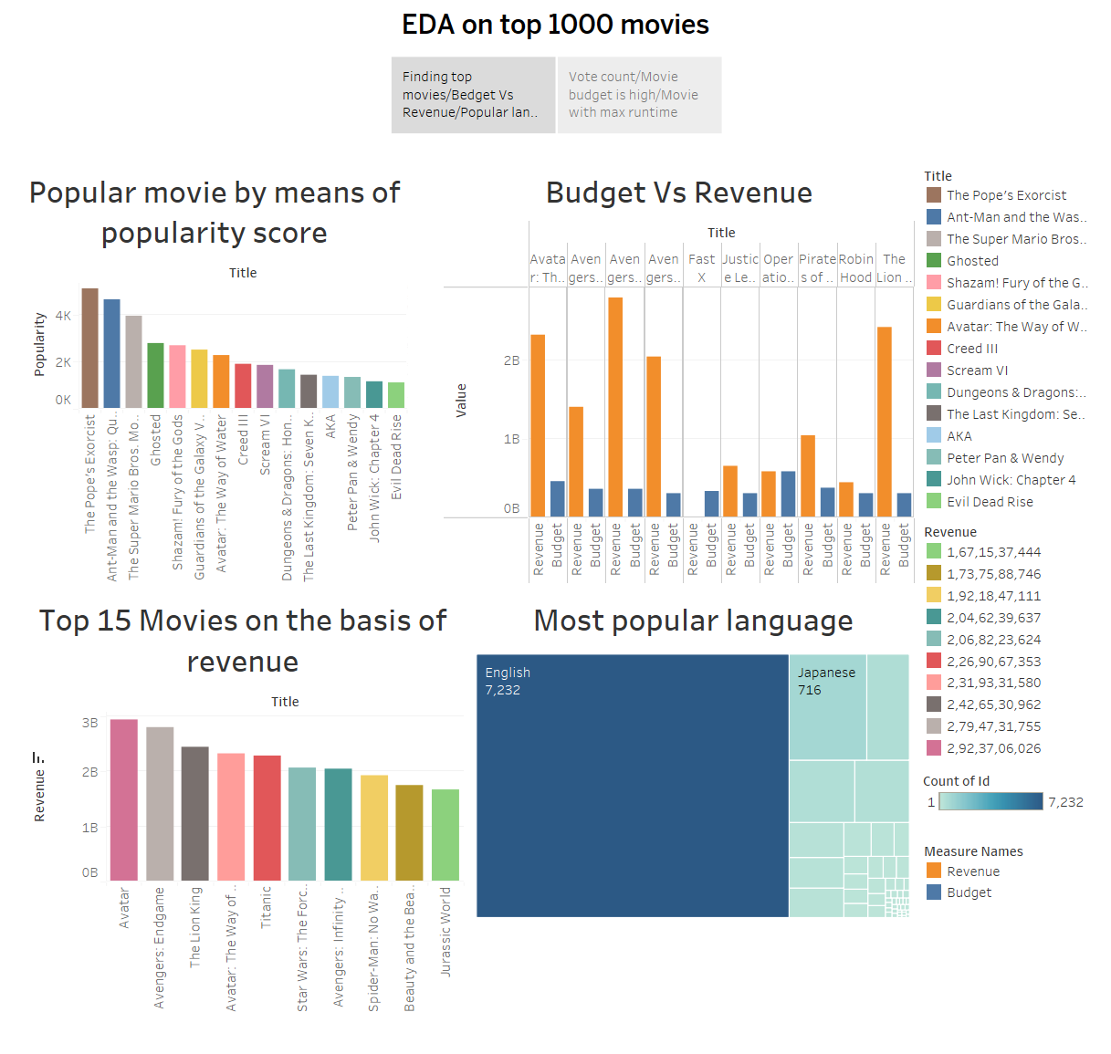

Slide 3
